Slide 1
Permissioned Based Blockchain
Juan Matiz, Liz Tucker
December 6th, 2019

Slide 2
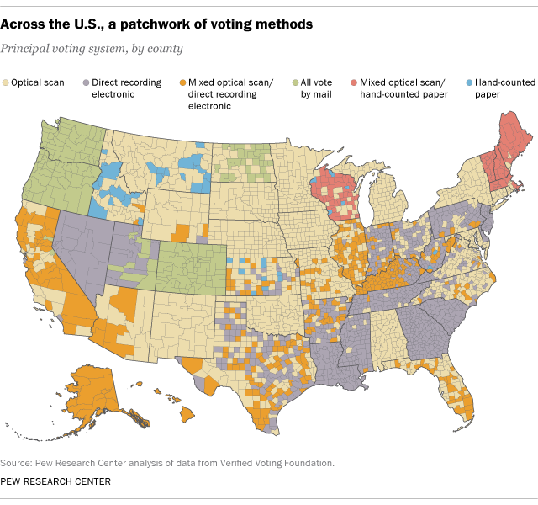
Background
https://www.pewresearch.org/fact-tank/2016/11/08/on-election-day-most-voters-use-electronic-or-optical-scan-ballots/
Notes:
2016 data obtained from Verified Voting Foundation (Non-partisan government organization)
47% of registered voters live in jurisdictions that use only optical scan as their only form of voting.
28% of registered voters live in jurisdictions that use only Direct Recording Electronic systems

Slide 3
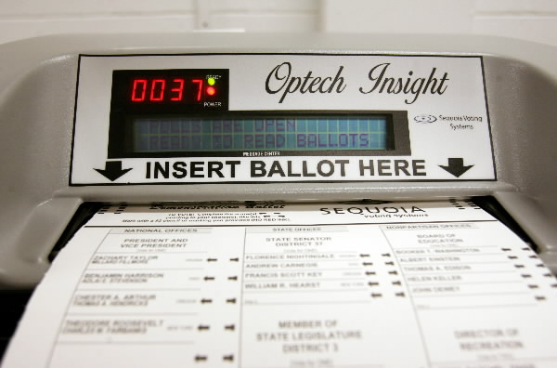
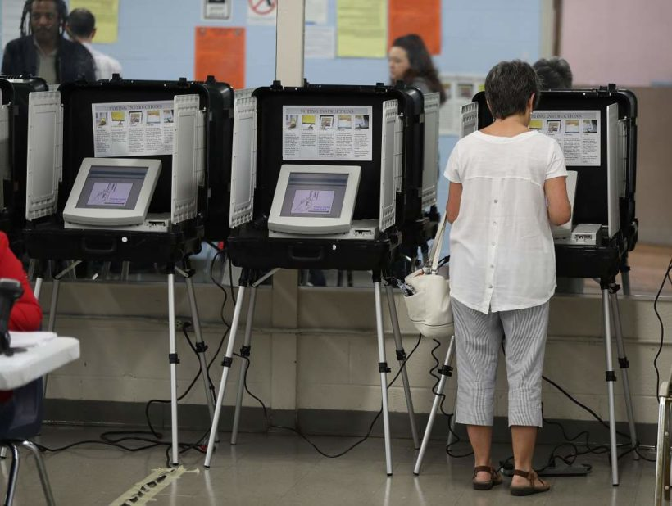
https://duckduckgo.com/?q=Sequoia+optical+scanner+voting+machine&t=ffab&iar=images&iax=images&ia=images&iai=http%3A%2F%2Fmedia.cmgdigital.com%2Fshared%2Fimg%2Fphotos%2F2012%2F03%2F31%2Fcc%2Fd8%2Fscanvoting_626000a.jpg
https://www.google.com/imgres?imgurl=https%3A%2F%2Fwww.studentnewsdaily.com%2Fwp-content%2Fuploads%2F2018%2F09%2Fgeorgia-voters-2017-820x618.jpg&imgrefurl=https%3A%2F%2Fwww.studentnewsdaily.com%2Fdaily-news-article%2Fjudge-rules-georgia-can-still-use-electronic-voting-machines-despite-concerns-over-hacking%2F&docid=RpsxL6XbVvGFnM&tbnid=N9x01A56wGSMFM%3A&vet=10ahUKEwjg8_Lqr53mAhUBU98KHY4_AKoQMwhqKA8wDw..i&w=820&h=618&bih=944&biw=1920&q=DRE%20voting%20machines&ved=0ahUKEwjg8_Lqr53mAhUBU98KHY4_AKoQMwhqKA8wDw&iact=mrc&uact=8

Slide 4
Concerns
Three-quarters of all DRE voting machines used in the United States do not provide a form of paper trail [1].
Electronic voting machines in Ohio and California where found to be using unpatched versions of voting software. [2]
Poor cryptographic algorithms implemented in these machines as well. [2]
Notes:
53,608 jurisdictions that use DRE equipment as their major voting method, almost three-quarters use systems that don’t create paper receipts or other hard-copy records of voters’ choices.

Slide 5
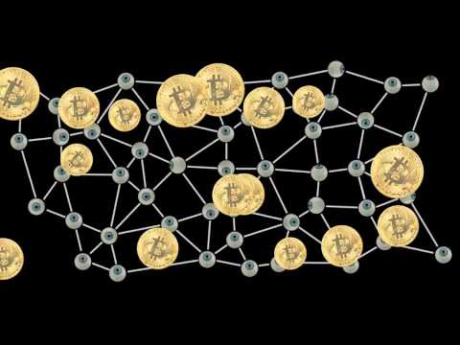
Solution?
Notes:
Time Stamp: 0:30 - 1:00

Slide 6
Research Objective
Develop a permissioned based blockchain network that will provide “voters” with a way to check that their vote is accounted for, and whether our system can prevent “bad actors” from tampering with the votes.

Slide 7
Methodology
Hyperledger Project
10 users
5 vote once for one “candidate”
5 attempt to vote twice for the same “candidate”
All votes are assumed to have unique numbers
Python Project
20 Voters
Each voter is assigned a voter id, vote number, candidate_hash, and time stamp.
Two candidates are assigned their own hash.
Merkle Root is created from the voter’s data.
All votes will be tampered by changing user’s candidate choice.

Slide 8

Hyperledger

Slide 9
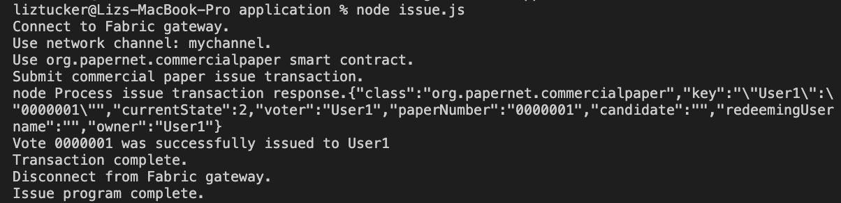
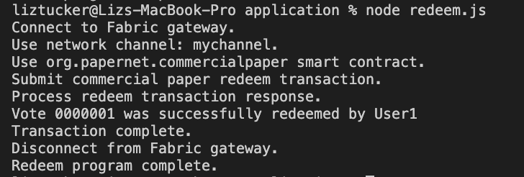

Slide 10
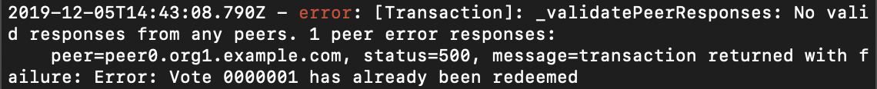
Results
Notes:
This solution is flawed, if a vote is issued twice with the same number, it may be redeemed twice.

Slide 11
Python: Merkle Tree
['8', '20', 'ab58daced56811e58567db766642b4db0cc3f475c0a687f528e070c9dd954640', '11/02/2020-01:58PM']
[‘Hash_ID, ‘Hash_vote_number, ‘Hash_candidate_number’, ‘Hash_time_stamp’]
[‘Hash_ID + Hash_vote’, ‘Hash_candidate_number + Hash_time_stamp’]
[‘Hash_ID&Vote’, ‘Hash_candidate&time_stamp’]
[‘Hash_ID&Vote + ‘Hash_candidate&time_stamp’]
[‘'e5519480f89c77c...'’]

Slide 12
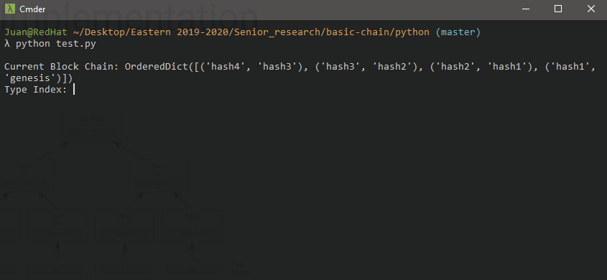
Python: OrderedDict

Slide 13
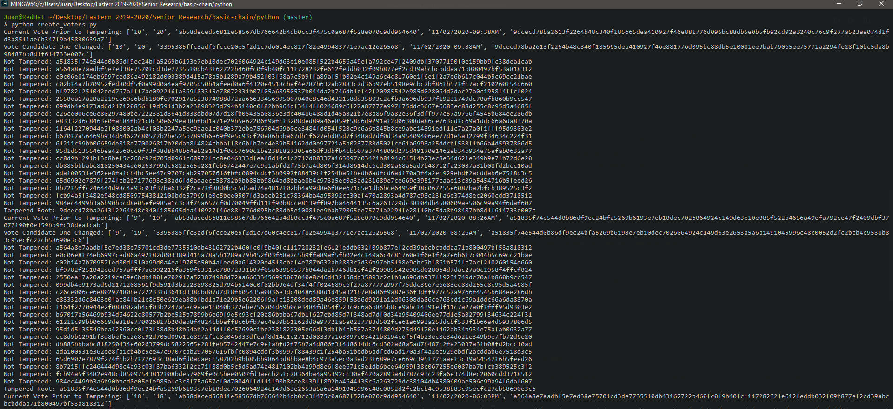
Results: Tamper Detection

Slide 14
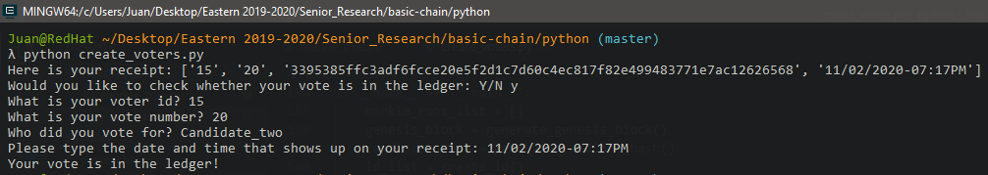
Results: Query Votes

Slide 15
Summary
Hyperledger solution’s current state is flawed
Limited architecture (organizations/peers/etc)
Does not enforce unique vote numbers
Python Proof of Concept
Merkle roots are an efficient way to verify data integrity.
Concerns regarding people being able to brute force the system.
Can be used to allow voters to verify that their vote is in the system.
Python dictionaries are not the ideal data structure for this concept.

Slide 16
Conclusion
Hyperledger
More work needed to enforce unique votes
Prevents the issue of double issuing votes and double redeeming votes
Architectural improvements needed for reinforcing the security of the ledger state
Python Proof of Concept
Would have been nice to have built a consensus mechanism to test block integrity.
Would have done this proof of concept in a different programming language.
Building in a vacuum does not proof that the concept actually works.

Slide 17
Citations
[1] 1615 L. St NW, Suite 800 Washington, and D. 20036USA202-419-4300 | M.-857-8562 | F.-419-4372 | M. Inquiries, “Most U.S. voters use electronic or optical-scan ballots,” Pew Research Center.
[2] D. Balzarotti et al., “Are Your Votes Really Counted?: Testing the Security of Real-world Electronic Voting Systems,” in Proceedings of the 2008 International Symposium on Software Testing and Analysis, New York, NY, USA, 2008, pp. 237–248.

Slide 18
Network Diagram
CA1
S1
P1
R1
L1
O1
NC1
Channel 1
Network
Notes:
R1 = Organization 1
NC1 = Network Config 1
O1= Orderer 1
CA1 = Certificate Authority 1
P1 = Peer Node # 1
L1 = Ledger 1
S1 = Smart Contract 1

Slide 19
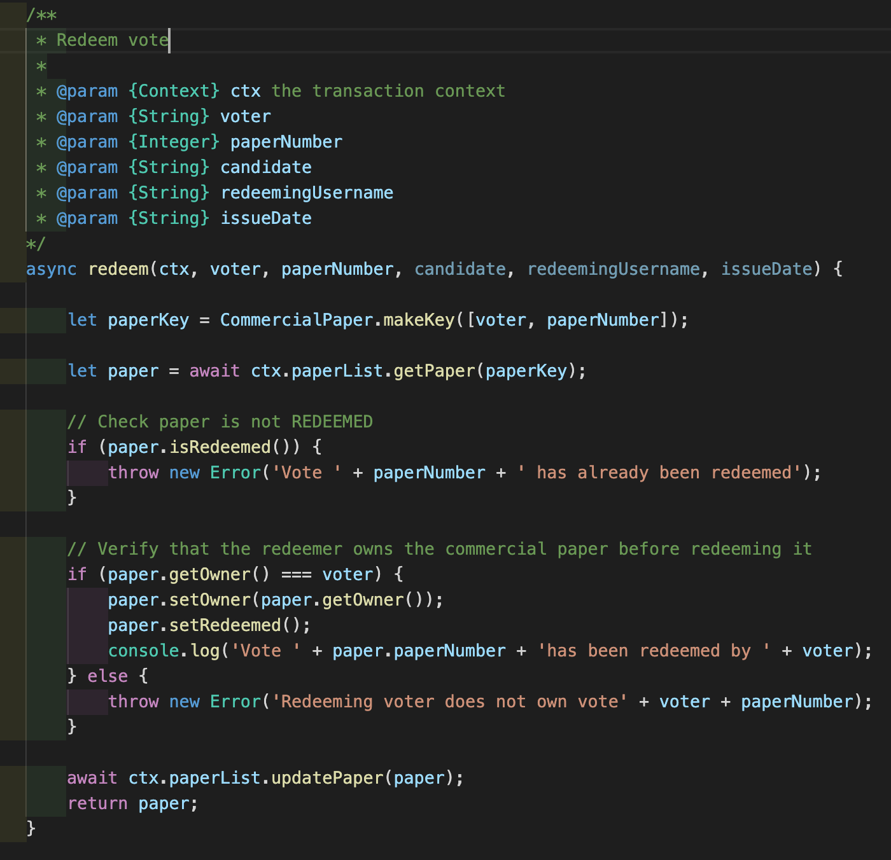
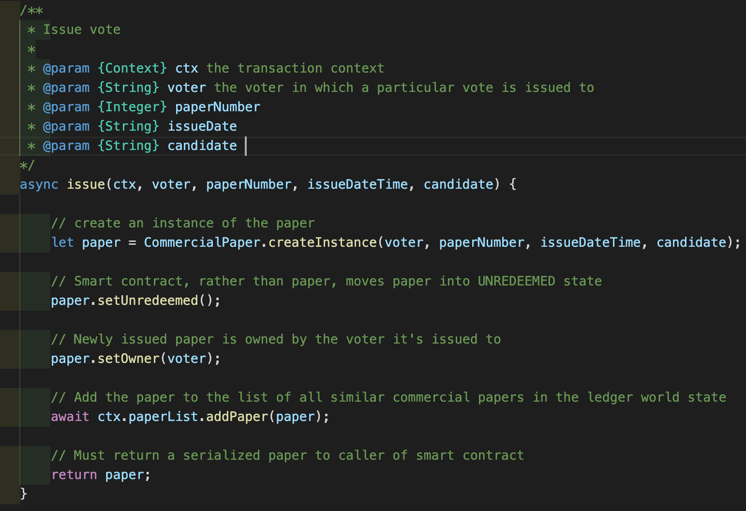
Chaincode

